Slide 1
Chapter 5
Statistical Models in Simulation
Banks, Carson, Nelson & Nicol
Discrete-Event System Simulation

Slide 2
Purpose & Overview
The world the model-builder sees is probabilistic rather than deterministic.
  Some statistical model might well describe the variations.
An appropriate model can be developed by sampling the phenomenon of interest:
  Select a known distribution through educated guesses
  Make estimate of the parameter(s)
  Test for goodness of fit
In this chapter:
  Review several important probability distributions
  Present some typical application of these models

Slide 3
Review of Terminology and Concepts
In this section, we will review the following concepts:
  Discrete random variables
  Continuous random variables
  Cumulative distribution function
  Expectation

Slide 4
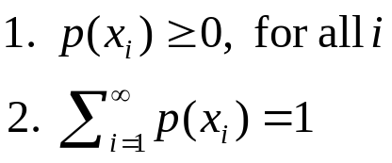
Discrete Random Variables [Probability Review]
X is a discrete random variable if the number of possible values of X is finite, or countably infinite.
Example: Consider jobs arriving at a job shop.
    Let X be the number of jobs arriving each week at a job shop.
    R_{x} = possible values of X (range space of X) = {0,1,2,…}
    p(x_{i}) = probability the random variable is x_{i} = P(X = x_{i})
  p(x_{i}), i = 1,2, … must satisfy:
  The collection of pairs [x_{i}, p(x_{i})], i = 1,2,…, is called the probability distribution of X, and p(x_{i}) is called the probability mass function (pmf) of X.

Slide 5
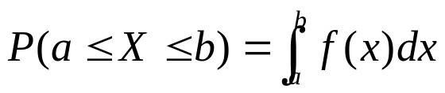
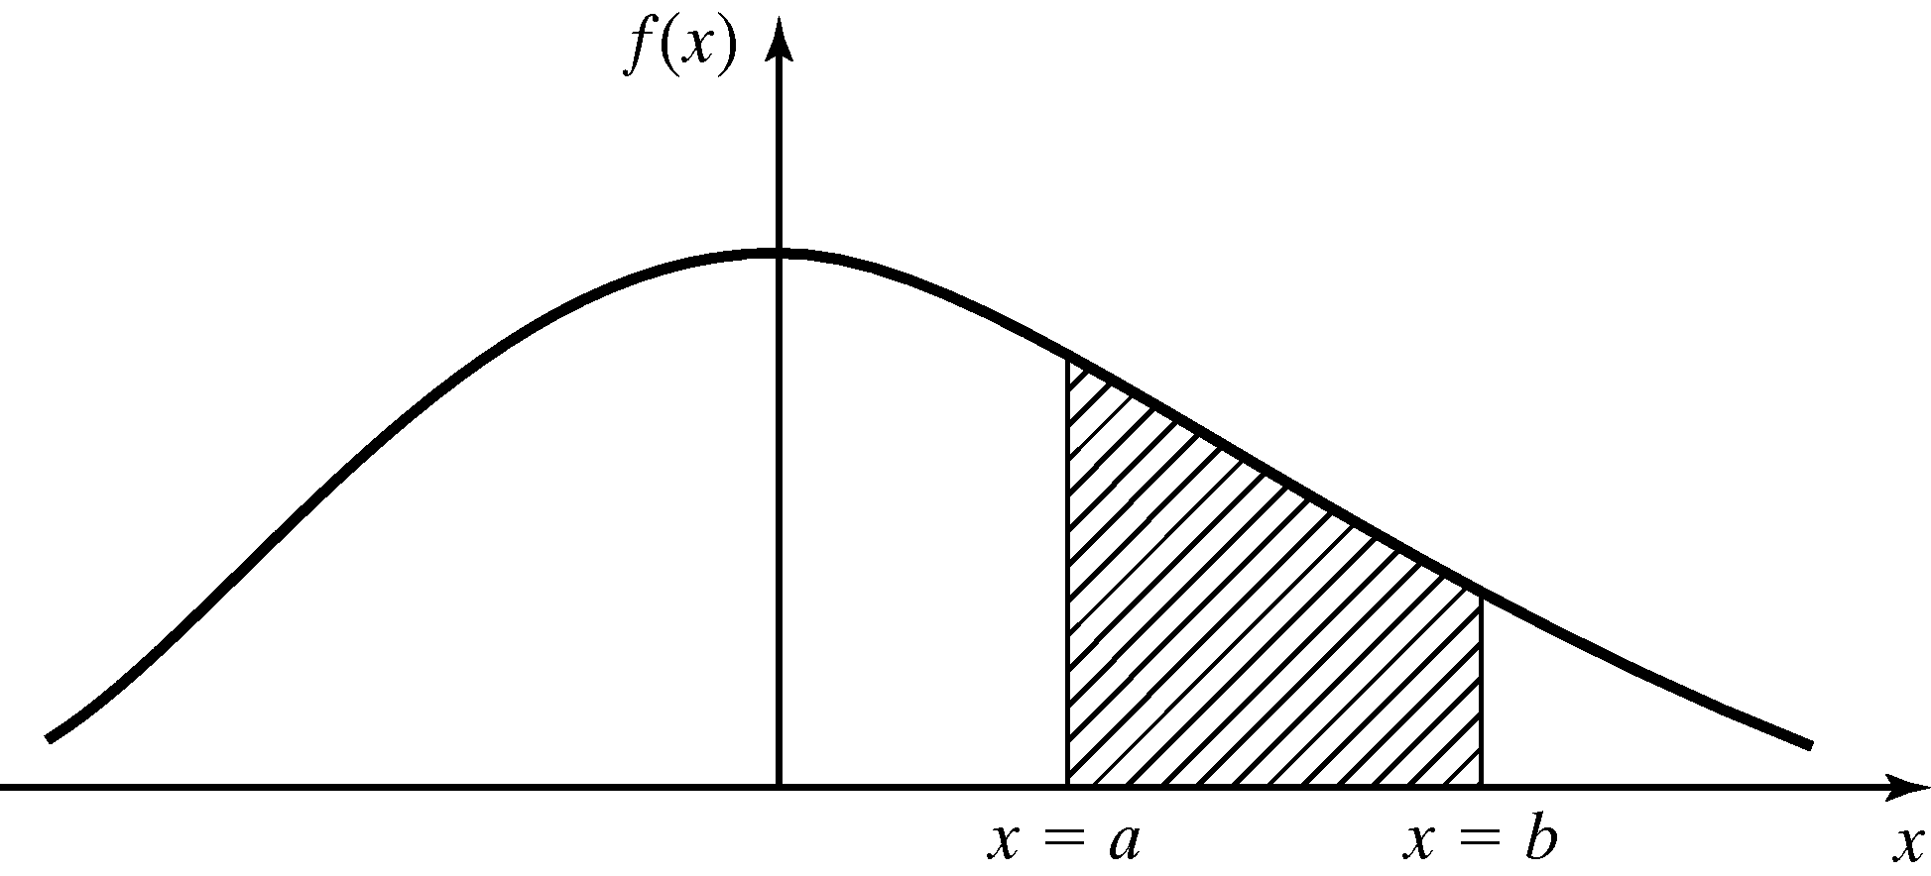
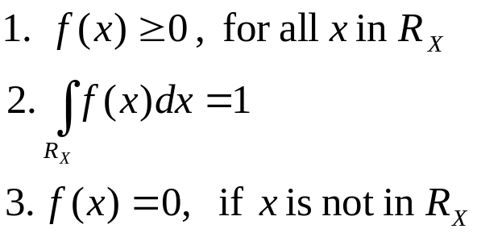
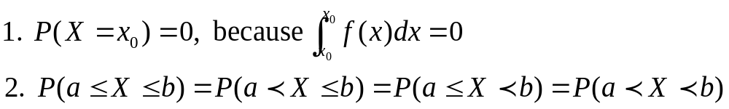
Continuous Random Variables [Probability Review]
X is a continuous random variable if its range space R_{x} is an interval or a collection of intervals.
The probability that X lies in the interval [a,b] is given by:
f(x), denoted as the pdf of X, satisfies:
Properties

Slide 6
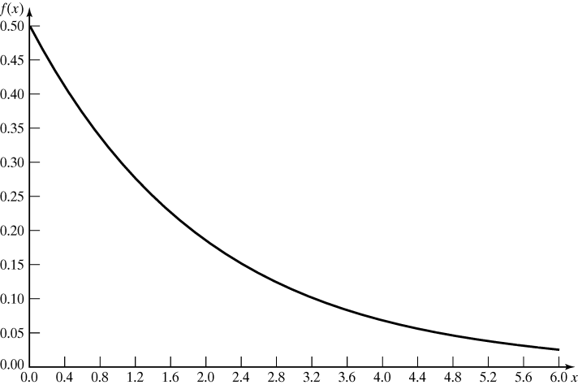
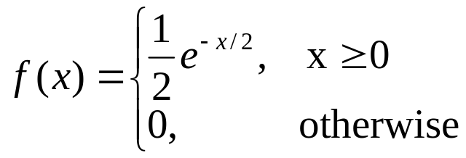
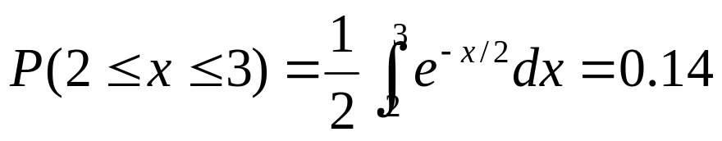
Continuous Random Variables [Probability Review]
Example: Life of an inspection device is given by X, a continuous random variable with pdf:
  X has an exponential distribution with mean 2 years
  Probability that the device’s life is between 2 and 3 years is:

Slide 7
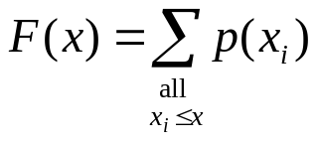
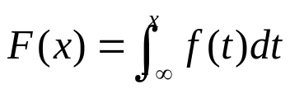
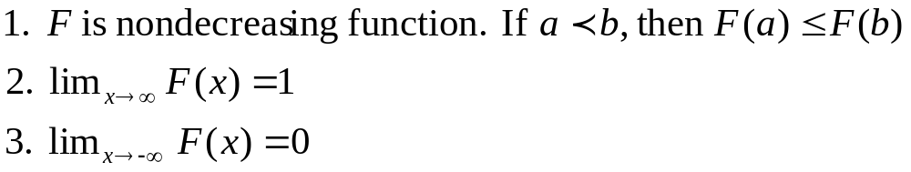
Cumulative Distribution Function [Probability Review]
Cumulative Distribution Function (cdf) is denoted by F(x), where F(x) = P(X <= x)
  If X is discrete, then
  If X is continuous, then
Properties
All probability question about X can be answered in terms of the cdf, e.g.:

Slide 8
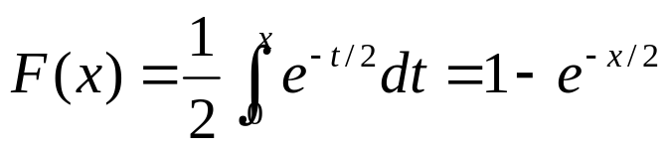
Cumulative Distribution Function [Probability Review]
Example: An inspection device has cdf:
  The probability that the device lasts for less than 2 years:
  The probability that it lasts between 2 and 3 years:

Slide 9
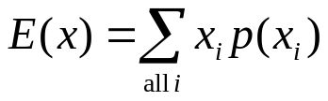
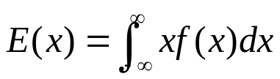
Expectation [Probability Review]
The expected value of X is denoted by E(X)
  If X is discrete
  If X is continuous
  a.k.a the mean, m, or the 1st moment of X
  A measure of the central tendency
The variance of X is denoted by V(X) or var(X) or σ²
  Definition: V(X) = E[(X – E[X]²]
  Also, V(X) = E(X²) – [E(x)]²
  A measure of the spread or variation of the possible values of X around the mean
The standard deviation of X is denoted by σ
  Definition: square root of V(X)
  Expressed in the same units as the mean

Slide 10
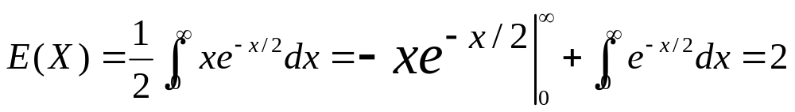
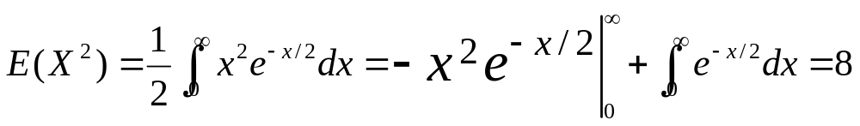
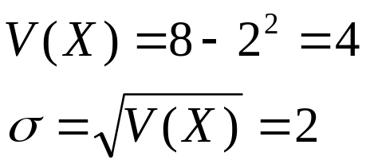
Expectations [Probability Review]
Example: The mean of life of the previous inspection device is:
To compute variance of X, we first compute E(X²):
Hence, the variance and standard deviation of the device’s life are:

Slide 11
Useful Statistical Models
In this section, statistical models appropriate to some application areas are presented. The areas include:
  Queueing systems
  Inventory and supply-chain systems
  Reliability and maintainability
  Limited data

Slide 12
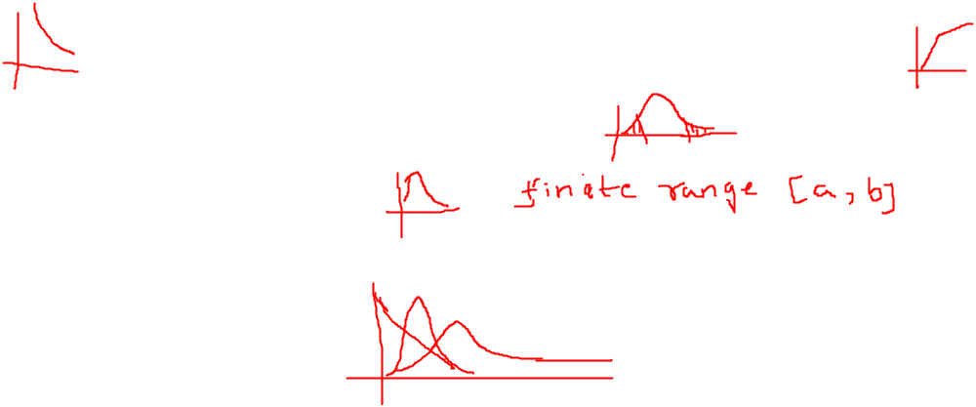
Queueing Systems [Useful Models]
In a queueing system, interarrival and service-time patterns can be probablistic (for more queueing examples, see Chapter 2).
Sample statistical models for interarrival or service time distribution:
  Exponential distribution: if service times are completely random
  Normal distribution: fairly constant but with some random variability (either positive or negative)
  Truncated normal distribution: similar to normal distribution but with restricted value.
  Gamma and Weibull distribution: more general than exponential (involving location of the modes of pdf’s and the shapes of tails.)

Slide 13
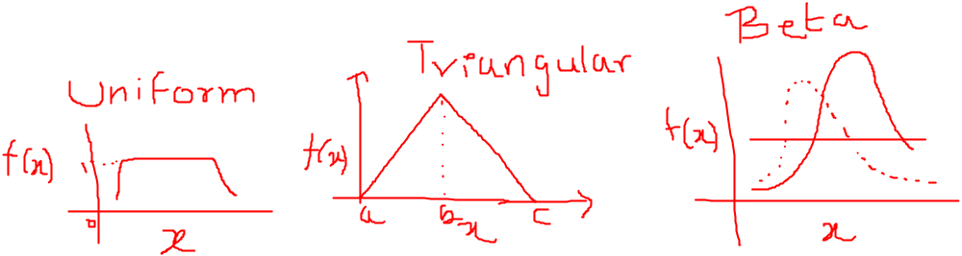
Other areas [Useful Models]
For cases with limited data, some useful distributions are:
  Uniform, triangular and beta
Other distribution: Bernoulli, binomial and hyperexponential.

Slide 14
Discrete Distributions
Discrete random variables are used to describe random phenomena in which only integer values can occur.
In this section, we will learn about:
  Bernoulli trials and Bernoulli distribution
  Binomial distribution
  Geometric and negative binomial distribution
  Poisson distribution

Slide 15
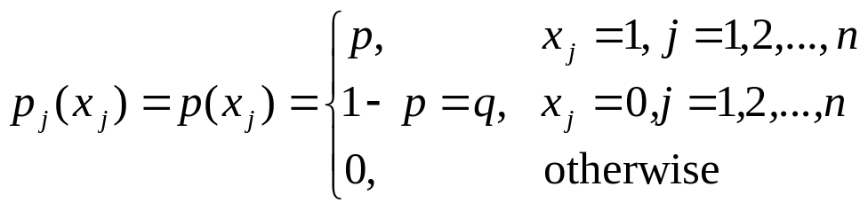
Bernoulli Trials and Bernoulli Distribution [Discrete Dist’n]
Bernoulli Trials:
  Consider an experiment consisting of n trials, each can be a success or a failure.
    Let X_{j} = 1 if the jth experiment is a success
    and X_{j} = 0 if the jth experiment is a failure
  The Bernoulli distribution (one trial):
  where E(X_{j}) = p and V(X_{j}) = p (1-p) = p
Bernoulli process:
  The n Bernoulli trials where trails are independent:
  p(x₁,x₂,…, x_{n}) = p₁(x₁) p₂(x₂) … p_{n}(x_{n})

Slide 16
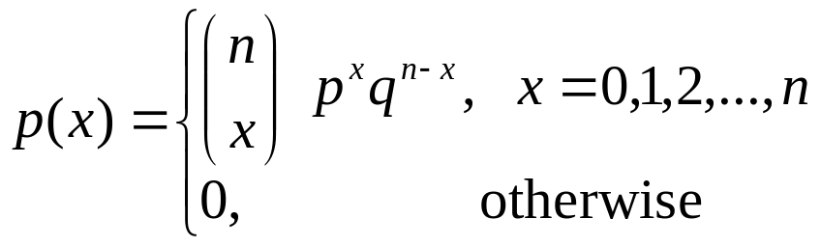
Binomial Distribution [Discrete Dist’n]
The number of successes in n Bernoulli trials, X, has a binomial distribution.
  The mean, E(x) = p + p + … + p = n*p
  The variance, V(X) = pq + pq + … + pq = n*pq
The number of outcomes having the required number of successes and failures
Probability that there are
x successes and (n-x) failures

Slide 17
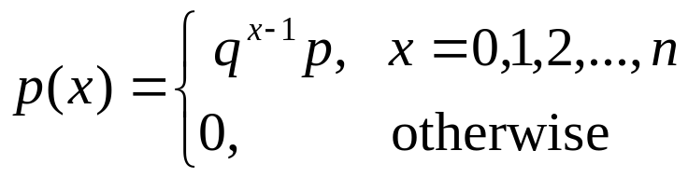
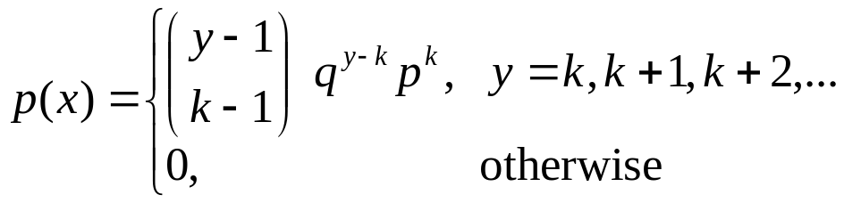
Geometric & Negative
Binomial Distribution [Discrete Dist’n]
Geometric distribution
  The number of Bernoulli trials, X, to achieve the 1st success:
  E(x) = 1/p, and V(X) = q/p²
Negative binomial distribution
  The number of Bernoulli trials, X, until the k^{th} success
  If Y is a negative binomial distribution with parameters p and k, then:
  E(Y) = k/p, and V(X) = kq/p²

Slide 18
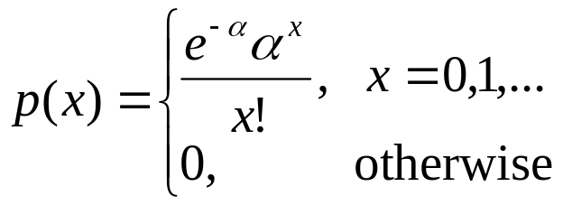
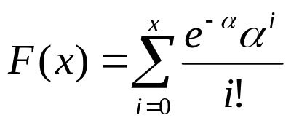
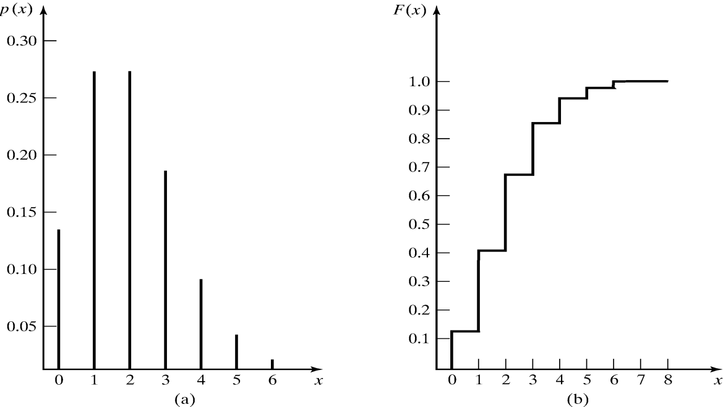
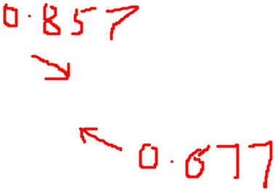
Poisson Distribution [Discrete Dist’n]
Poisson distribution describes many random processes quite well and is mathematically quite simple.
  where α > 0, pdf and cdf are:
  E(X) = α = V(X)

Slide 19
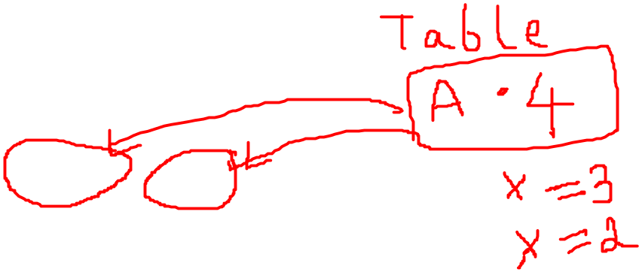
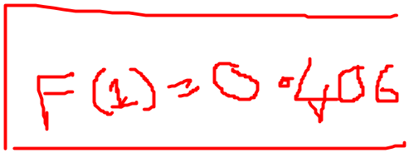
Poisson Distribution [Discrete Dist’n]
Example: A computer repair person is “beeped” each time there is a call for service. The number of beeps per hour ~ Poisson(α = 2 per hour).
  The probability of three beeps in the next hour:
  p(3) = e⁻²2³/3! = 0.18
  also, p(3) = F(3) – F(2) = 0.857-0.677=0.18
  The probability of two or more beeps in a 1-hour period:
  p(2 or more) = 1 – p(0) – p(1)
  = 1 – F(1)
  = 0.594

Slide 20
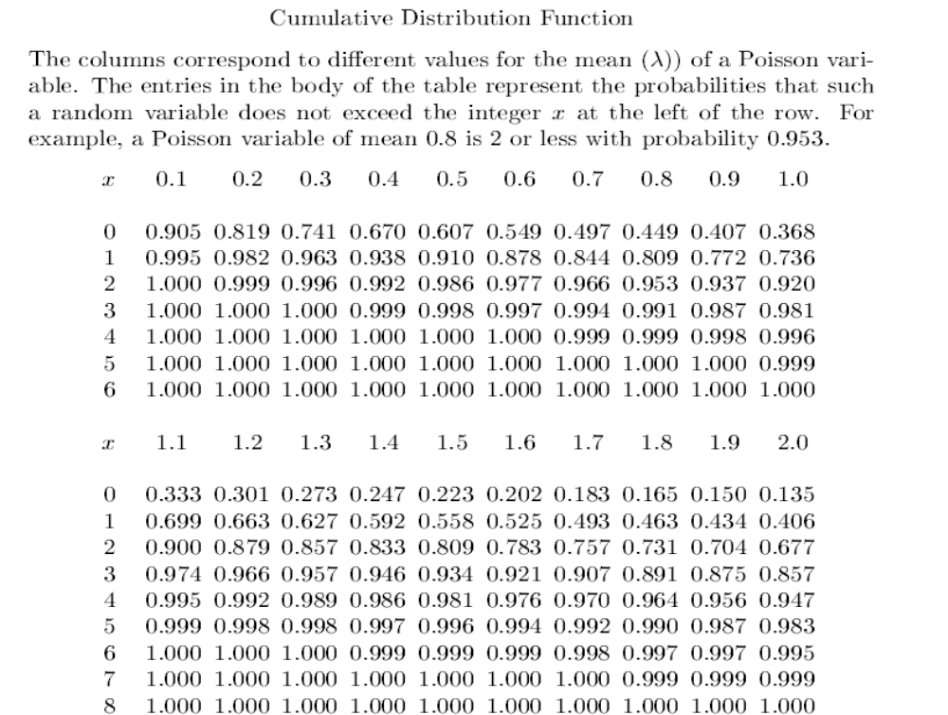




Slide 21
Continuous Distributions
Continuous random variables can be used to describe random phenomena in which the variable can take on any value in some interval.
In this section, the distributions studied are:
  Uniform
  Exponential
  Normal
  Weibull
  Lognormal

Slide 22
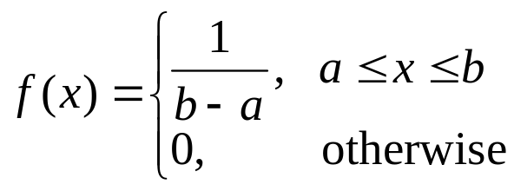
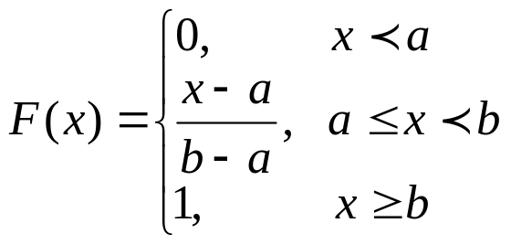
Uniform Distribution [Continuous Dist’n]
A random variable X is uniformly distributed on the interval (a,b), U(a,b), if its pdf and cdf are:
Properties
  P(x₁ < X < x₂) is proportional to the length of the interval [F(x₂) – F(x₁) = (x₂-x₁)/(b-a)]
  E(X) = (a+b)/2 V(X) = (b-a)²/12
U(0,1) provides the means to generate random numbers, from which random variates can be generated.

Slide 23
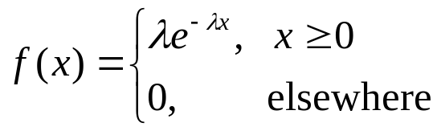
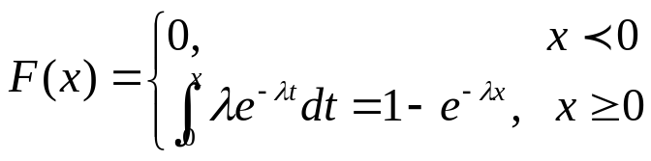
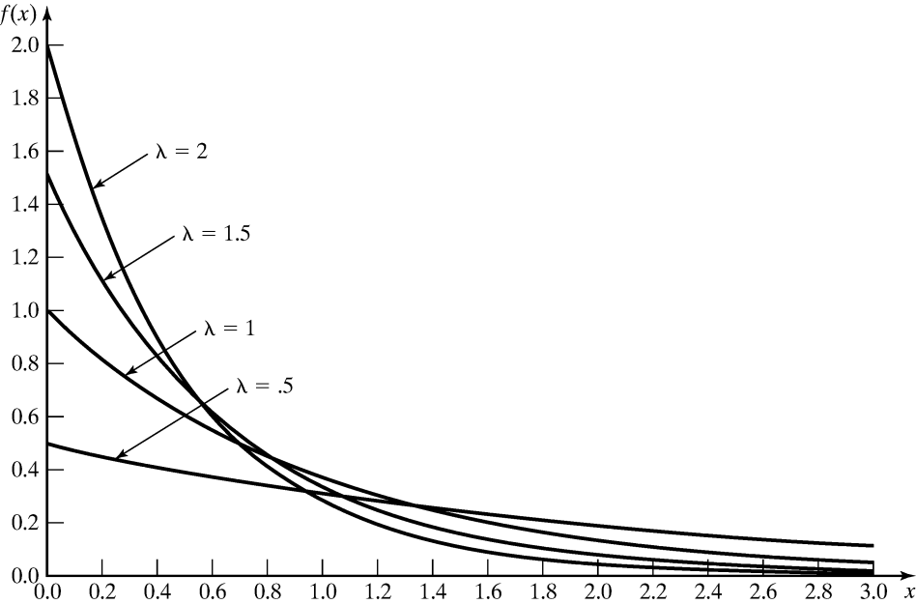
Exponential Distribution [Continuous Dist’n]
A random variable X is exponentially distributed with parameter λ > 0 if its pdf and cdf are:
  E(X) = 1/λV(X) = 1/λ²
  Used to model interarrival times when arrivals are completely random, and to model service times that are highly variable
  For several different exponential pdf’s (see figure), the value of intercept on the vertical axis is λ, and all pdf’s eventually intersect.

Slide 24
Exponential Distribution [Continuous Dist’n]
Memoryless property
  For all s and t greater or equal to 0:
  P(X > s+t | X > s) = P(X > t)
  Example: A lamp ~ exp(λ = 1/3 per hour), hence, on average, 1 failure per 3 hours.
    The probability that the lamp lasts longer than its mean life is: P(X > 3) = 1-(1-e^{-3/3}) = e⁻¹ = 0.368
    The probability that the lamp lasts between 2 to 3 hours is:
    P(2 <= X <= 3) = F(3) – F(2) = 0.145
    The probability that it lasts for another hour given it is operating for 2.5 hours:
    P(X > 3.5 | X > 2.5) = P(X > 1) = e^{-1/3} = 0.717

Slide 25
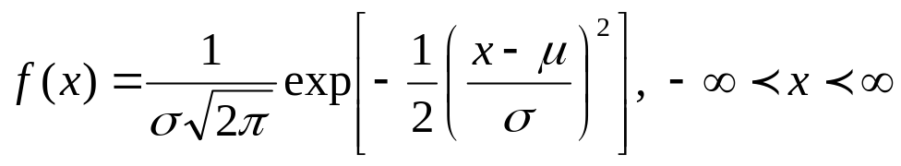
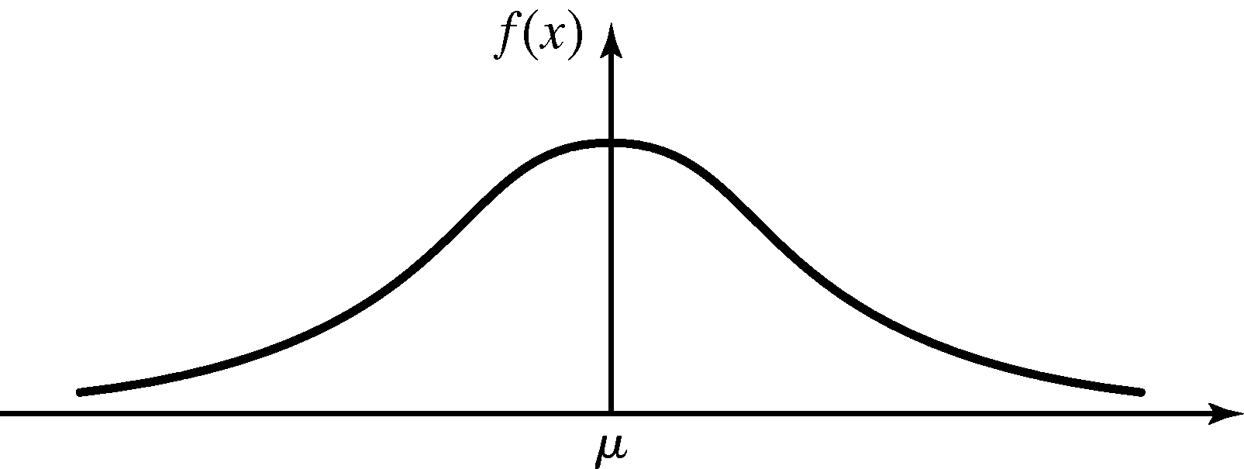


Normal Distribution [Continuous Dist’n]
A random variable X is normally distributed has the pdf:
  Mean:
  Variance:
  Denoted as X ~ N(μ,σ²)
Special properties:
  .
  f(μ-x)=f(μ+x); the pdf is symmetric about μ.
  The maximum value of the pdf occurs at x = μ; the mean and mode are equal.

Slide 26
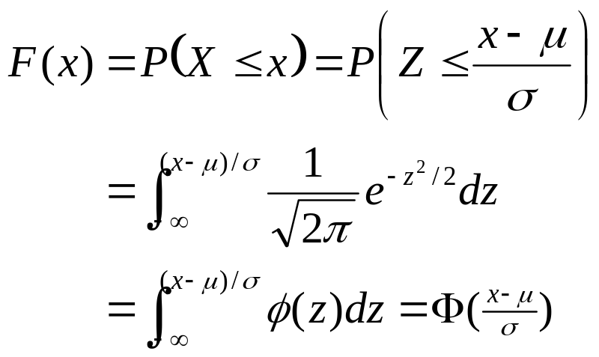
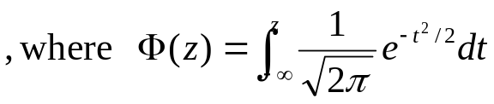
Normal Distribution [Continuous Dist’n]
Evaluating the distribution:
  Use numerical methods (no closed form)
  Independent of μ and σ, using the standard normal distribution:
  Z ~ N(0,1)
  Transformation of variables: let Z = (X - μ) / σ,

Slide 27
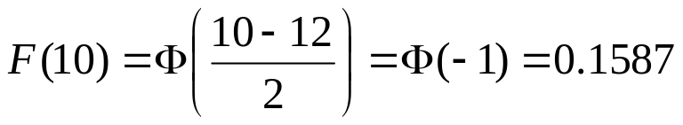
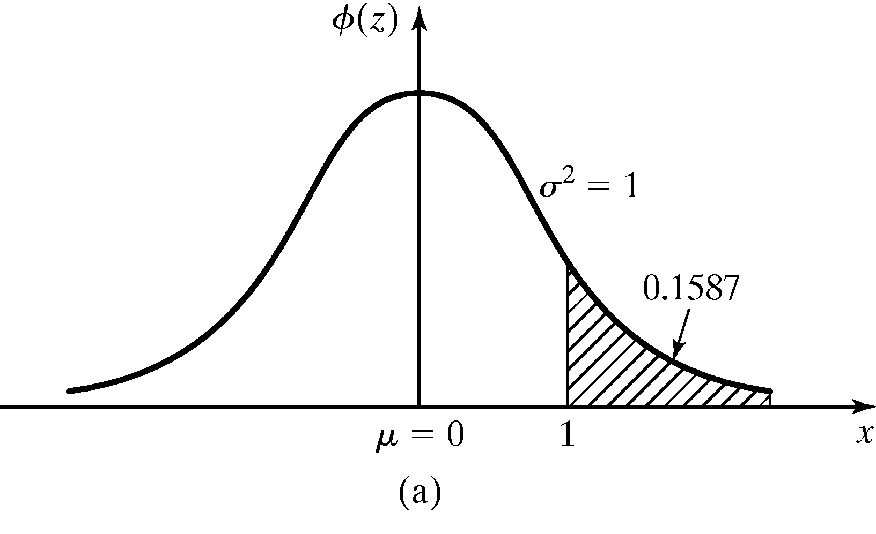
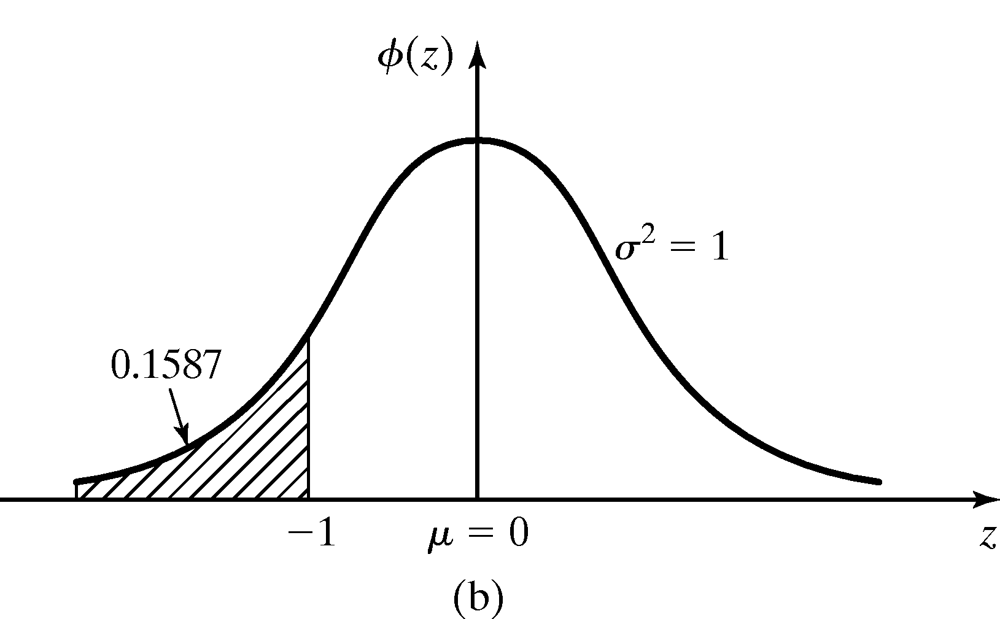
Normal Distribution [Continuous Dist’n]
Example: The time required to load an oceangoing vessel, X, is distributed as N(12,4)
  The probability that the vessel is loaded in less than 10 hours:
    Using the symmetry property, Φ(1) is the complement of Φ (-1)

Slide 28
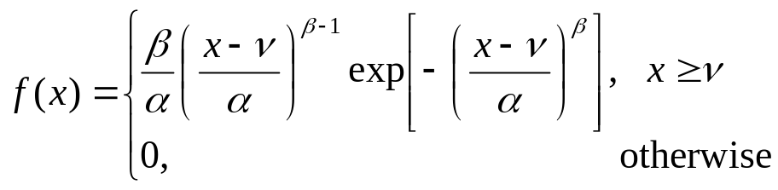

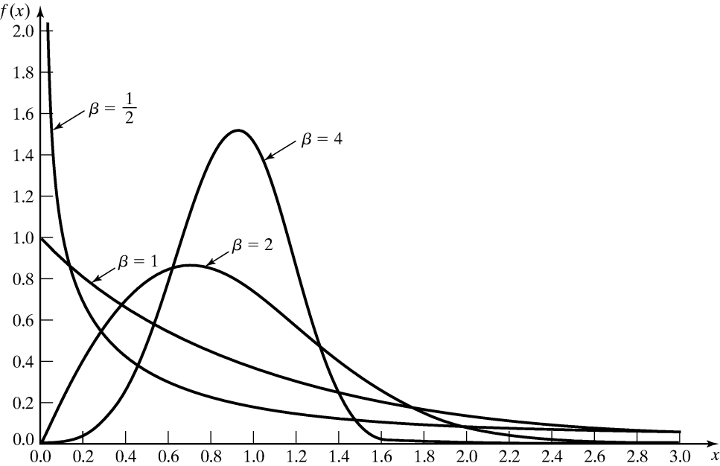

Weibull Distribution [Continuous Dist’n]
A random variable X has a Weibull distribution if its pdf has the form:
3 parameters:
  Location parameter: υ,
  Scale parameter: β , (β > 0)
  Shape parameter. α, (> 0)
Example: υ = 0 and α = 1:
When β = 1,
X ~ exp(λ = 1/α)

Slide 29
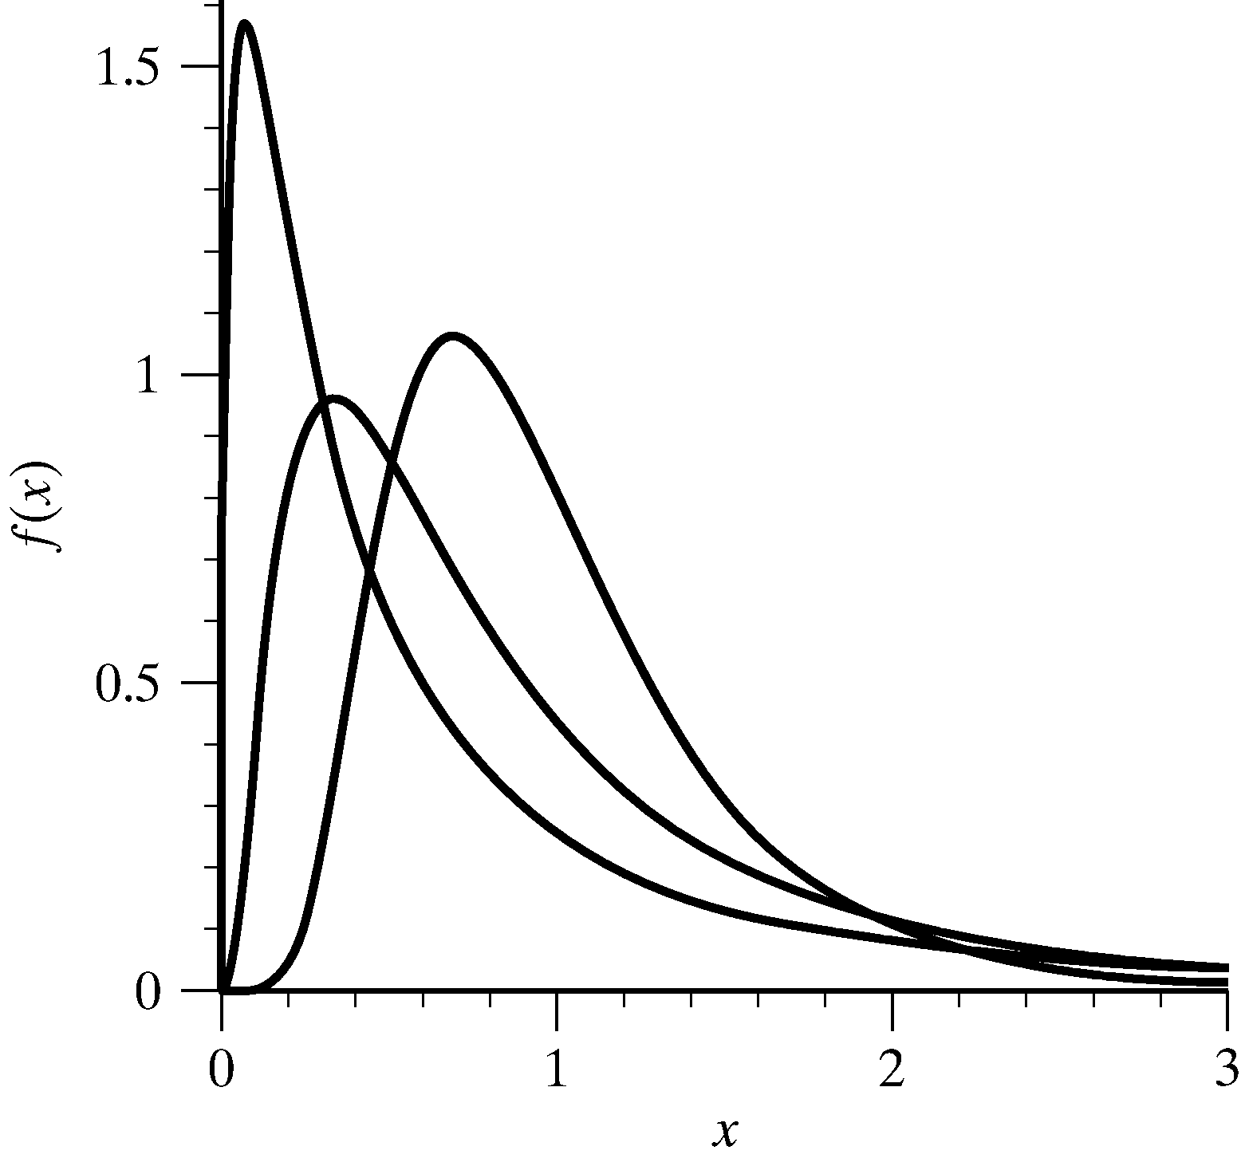
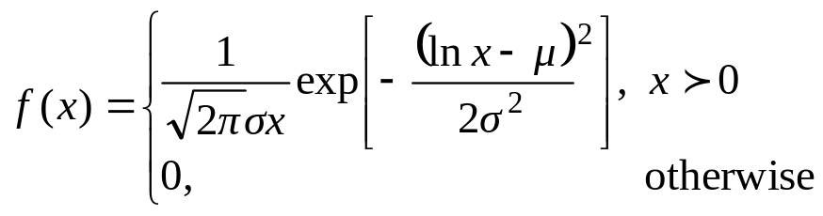
Lognormal Distribution [Continuous Dist’n]
A random variable X has a lognormal distribution if its pdf has the form:
  Mean E(X) = e^{μ+σ2/2}
  Variance V(X) = e^{2μ+σ2/2 (}e^{σ2} - 1)
Relationship with normal distribution
  When Y ~ N(μ, σ²), then X = e^{Y} ~ lognormal(μ, σ²)
  Parameters μ and σ² are not the mean and variance of the lognormal
μ=1, σ2=0.5,1,2.

Slide 30
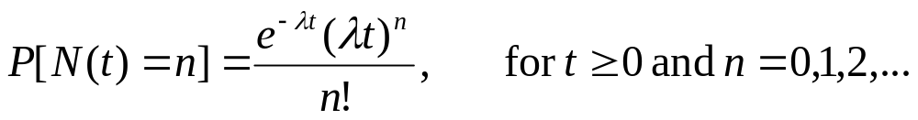
Poisson Distribution
Definition: N(t) is a counting function that represents the number of events occurred in [0,t].
A counting process {N(t), t>=0} is a Poisson process with mean rate λ if:
  Arrivals occur one at a time
  {N(t), t>=0} has stationary increments
  {N(t), t>=0} has independent increments
Properties
  Equal mean and variance: E[N(t)] = V[N(t)] = λt
  Stationary increment: The number of arrivals in time s to t is also Poisson-distributed with mean λ(t-s)

Slide 31
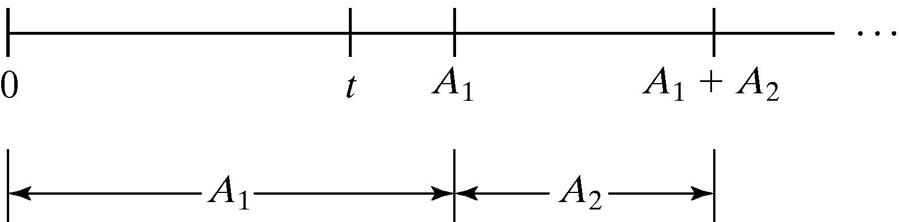

Interarrival Times [Poisson Dist’n]
Consider the interarrival times of a Possion process (A₁, A₂, …), where A_{i} is the elapsed time between arrival i and arrival i+1
  The 1st arrival occurs after time t iff there are no arrivals in the interval [0,t], hence:
  P{A₁ > t} = P{N(t) = 0} = e^{-λt}
  P{A₁ <= t} = 1 – e^{-λt} [cdf of exp(λ)]
  Interarrival times, A₁, A₂, …, are exponentially distributed and independent with mean 1/λ
Arrival counts ~ Poi(λ)
Interarrival time ~ Exp(1/λ)
Stationary & Independent
Memoryless

Slide 32
Splitting and Pooling [Poisson Dist’n]
Splitting:
  Suppose each event of a Poisson process can be classified as Type I, with probability p and Type II, with probability 1-p.
  N(t) = N1(t) + N2(t), where N1(t) and N2(t) are both Poisson processes with rates λ p and λ (1-p)
Pooling:
  Suppose two Poisson processes are pooled together
  N1(t) + N2(t) = N(t), where N(t) is a Poisson processes with rates λ₁ + λ₂
λp
N1(t) ~ Poi[λp]
N(t) ~ Poi(λ)
λ
λ(1-p)
N2(t) ~ Poi[λ(1-p)]
N1(t) ~ Poi[λ₁]
λ₁
λ₁ + λ₂
N(t) ~ Poi(λ₁ + λ₂)
N2(t) ~ Poi[λ₂]
λ₂

Slide 33
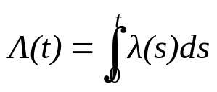
Nonstationary Poisson
Process (NSPP) [Poisson Dist’n]
Poisson Process without the stationary increments, characterized by λ(t), the arrival rate at time t.
The expected number of arrivals by time t, Λ(t):
Relating stationary Poisson process n(t) with rate λ=1 and NSPP N(t) with rate λ(t):
  Let arrival times of a stationary process with rate λ = 1 be t₁, t₂, …, and arrival times of a NSPP with rate λ(t) be T₁, T₂, …, we know: t_{i} = Λ(T_{i})
  T_{i} = Λ⁻¹(t_{i})

Slide 34
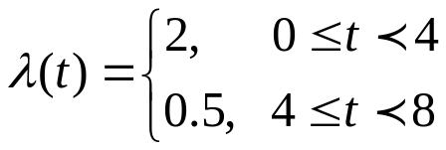

Nonstationary Poisson
Process (NSPP) [Poisson Dist’n]
Example: Suppose arrivals to a Post Office have rates 2 per minute from 8 am until 12 pm, and then 0.5 per minute until 4 pm.
Let t = 0 correspond to 8 am, NSPP N(t) has rate function:
Expected number of arrivals by time t:
Hence, the probability distribution of the number of arrivals between 11 am and 2 pm.
P[N(6) – N(3) = k] = P[N(Λ(6)) – N(Λ(3)) = k]
= P[N(9) – N(6) = k]
= e⁽⁹⁻⁶⁾(9-6)^{k}/k! = e³(3)^{k}/k!

Slide 35
Empirical Distributions [Poisson Dist’n]
A distribution whose parameters are the observed values in a sample of data.
  May be used when it is impossible or unnecessary to establish that a random variable has any particular parametric distribution.
  Advantage: no assumption beyond the observed values in the sample.
  Disadvantage: sample might not cover the entire range of possible values.

Slide 36
Summary
The world that the simulation analyst sees is probabilistic, not deterministic.
In this chapter:
  Reviewed several important probability distributions.
  Showed applications of the probability distributions in a simulation context.
Important task in simulation modeling is the collection and analysis of input data, e.g., hypothesize a distributional form for the input data. Reader should know:
  Difference between discrete, continuous, and empirical distributions.
  Poisson process and its properties.

